Slide 1
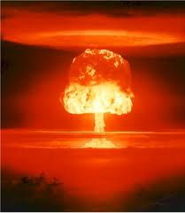
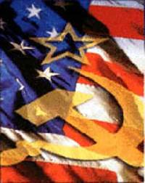
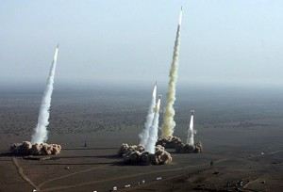
The Cold War
Outcome: Why a Cold War?

Slide 2
Why a cold war?
Setting the stage: During and After WWII
The U.S. and Soviet Union were allies during WWII
Both counties spied on each other during WWII
Both wanted to share as little as possible in the victory over the axis powers
Communism was spreading
Stalin took over Eastern Europe ---> The Iron Curtain
Mao Zedong created the People’s Republic of China in 1949
North Korea
Vietnam

Slide 3
The Iron curtain

Slide 4
Why a cold war?
Five W’s & How:
What was it and who fought it?
Hostility between post-WWII superpowers:
The U.S. (Free World) versus USSR (Communist World)
Would last about 45 years
Neither country directly fought one another

Slide 5
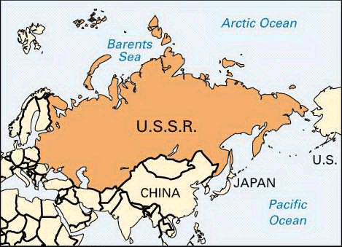

Slide 6
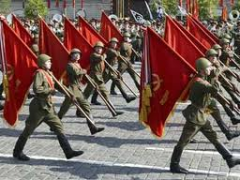
Why a cold war?
Where was it fought?
Wherever Communism threatened globally

Slide 7
Why a cold war?
How was it fought?
Arms Race (each side built up huge nuclear arsenals)
1949 – USSR achieved an Atomic Explosion
Technology on both sides led to advanced:
Destructive power
Numbers of weapons (Mutually Assured Destruction)
Methods of delivery
Goal: Maintain the “balance of power” or if possible, gain the advantage

Slide 8
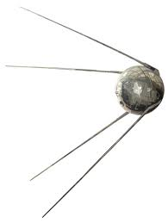
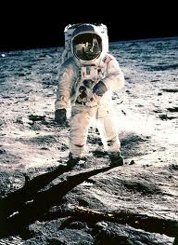
Why a cold war?
Space Race (1957-1969)
Launching satellites (sputnik 1957; Soviet victory)
Race to the moon (U.S. victory)

Slide 9
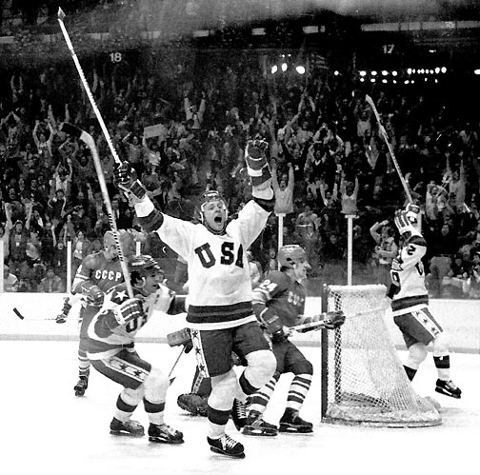
Why a cold war?
Sports and Movies
Olympic Games served as a Cold War battlefield

Slide 10
1980 Winter olympics
US team coached by Herb Brooks
Soviet Union won the gold medal in hockey in 1956, 1964, 1968, 1972, & 1976
US team was made up of college amateurs
US won semi-final game
US would go on to win gold
Seen as more than a hockey game
Considered greatest sports moment in history (for US)

Slide 11
Why a cold war?
Sports and Movies
Olympic Games served as a Cold War battlefield
Stereotypes:
We portrayed the Soviets as cold & ruthless
They portrayed Americans as spoiled & undisciplined
Goal: To prove physical superiority
A Race for World Influence
Goal: To outnumber the opponent (U.S. Goal = Containment)

Slide 12
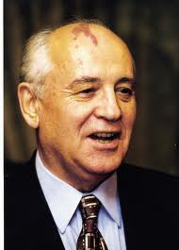
Why a cold war?
Why did the U.S. win the Cold War?
In the long run, USSR’s weaker Communist system could not keep up the race; economic collapse
Mikhail Gorbachev was elected in USSR in 1985 (introduced democratic reforms)
Soviet Union collapsed in 1991

