Slide 1
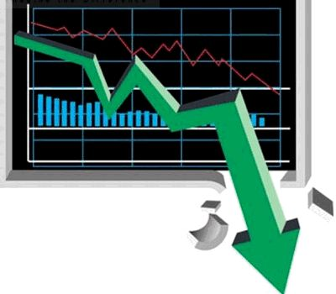
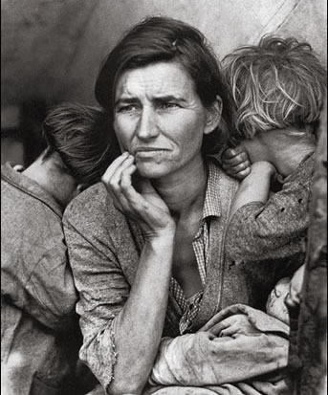
The
Great Depression

Slide 2
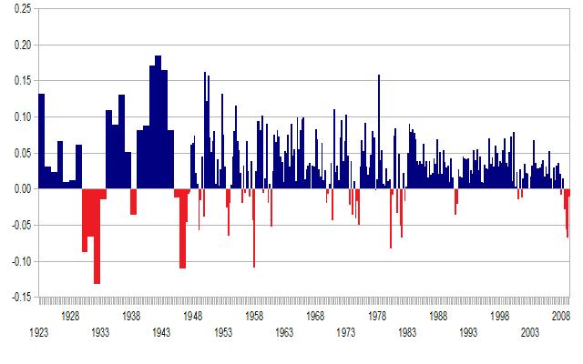
USA Gross Domestic Product

Slide 3
The Great Depression
$95
$99
$1
$5
$1
Buy Less
$0
Buy Less
Less Workers
Make Less

Slide 4
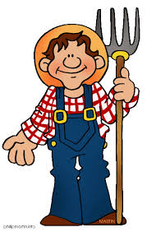
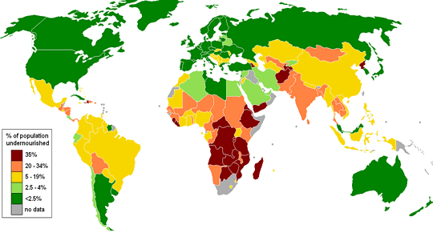
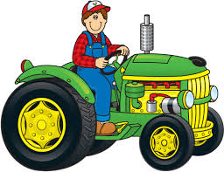
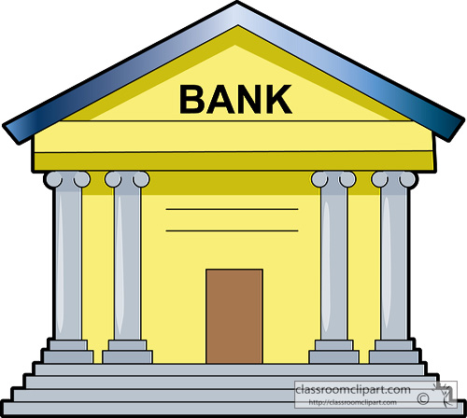
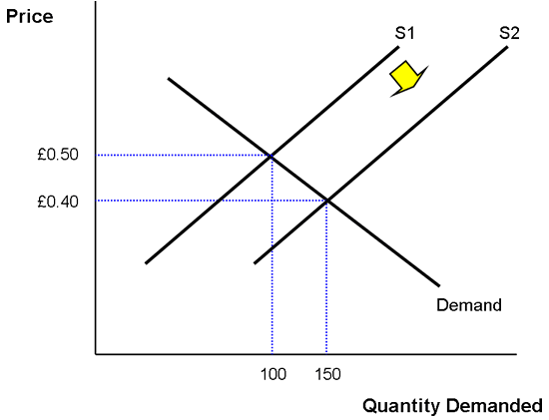
Buy Less
Supply
Price
The Great Depression

Slide 5
The Great Depression
$95
$99
$1
$5
$1
Buy Less
$0
Buy Less
Less Workers
Make Less

Slide 6
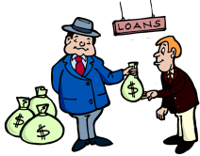
Buy Less
Supply
Price

Slide 7
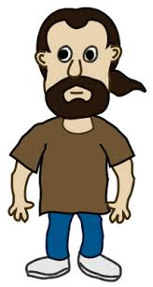
Buy MORE!
The Great Depression

Slide 8
Buy MORE!
Buy EVEN
LESS!
Buy LESS!
The Great Depression

Slide 9
The Great Depression
$95
$99
$1
$5
$1
Buy Less
$0
Buy Less
Less Workers
Make Less

Slide 10
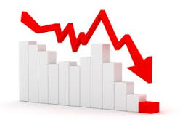
The Great Depression
$2
$7
$5
no more investing

Slide 11
The Great Depression
$95
$99
$1
$5
$1
Buy Less
$0
Buy Less
Less Workers
Make Less

Slide 12
The Great Depression
$2
$7
$5
no more investing

Slide 13
Buy MORE!
Buy LESS!
The Great Depression

Slide 14
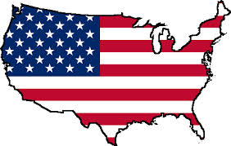
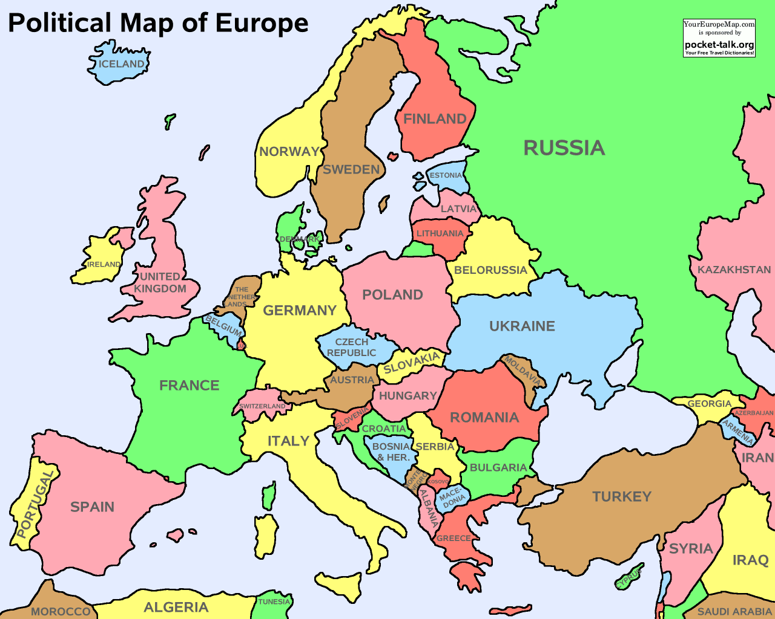
The Great Depression
Buy Less
Buy MORE!

Slide 15
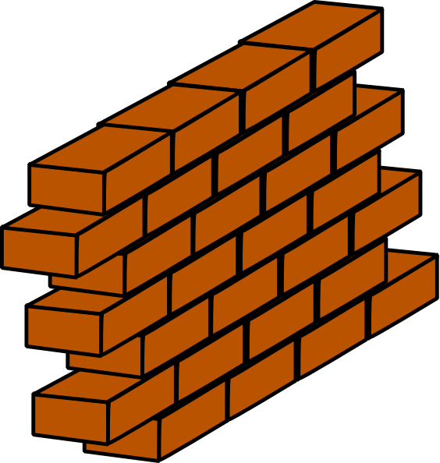
The Great Depression
$100 Tax to Export to US
Tariff
Less People to Sell
Make Less
Less Workers

Slide 16
The Great Depression
$100 Tax to Export to France
$100 Tax to Export to US
Tariff
Less People to Sell
Less People to Sell
Make Less
Less Workers

Slide 17
The
Great Depression

Slide 18
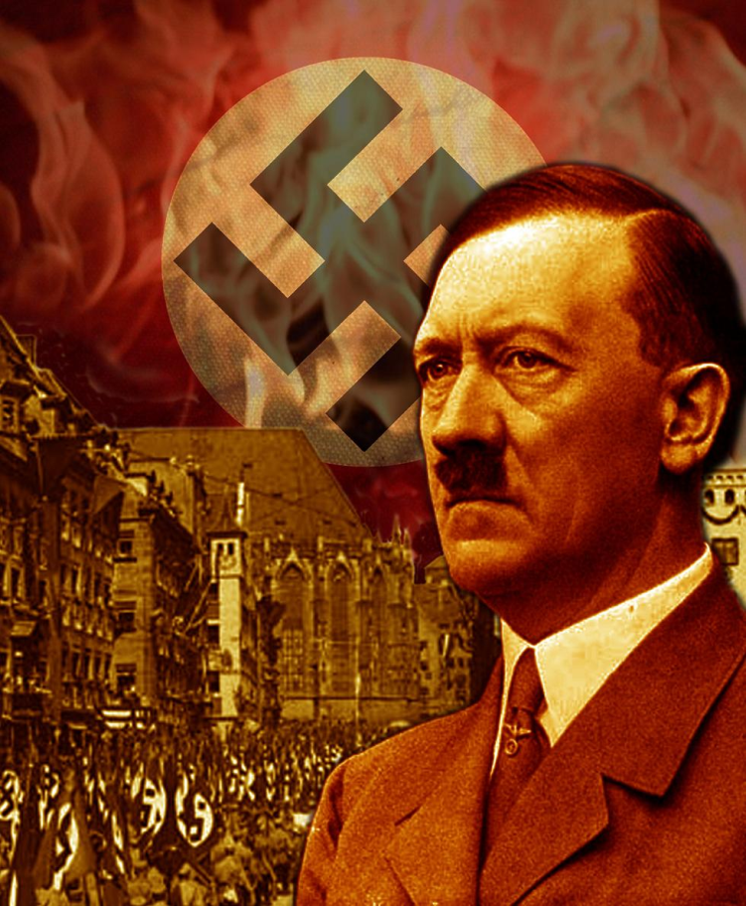
Rise of Dictators
Post WWI countries in rough shape
BUT they rebound – Europe is doing well
THEN The Great Depression
Europe falls apart
People are unemployed
No money, no food
Desperately want help
Turn to anyone

Slide 19
Rise of Dictators
Fascism
Militant Political Movement
Emphasized
Loyalty to the nation (extreme nationalism)
Obedience to the leader
Belief
Do not care about individual rights or democracy
Do not care about communism or capitalism
Its all about making the nation strong
Totalitarian gov’t
Violence, War, and Imperialism are necessary

Slide 20
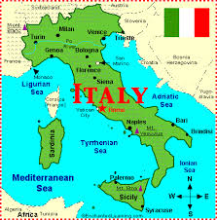
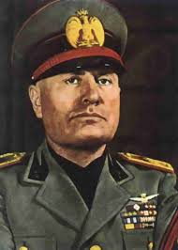
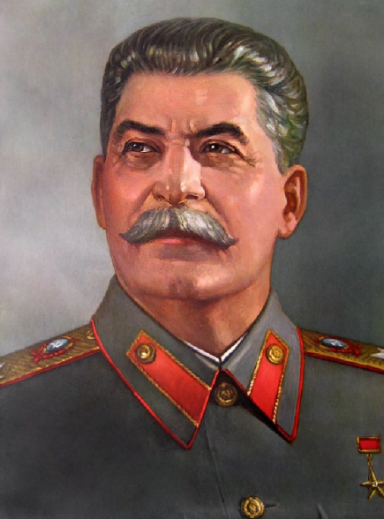
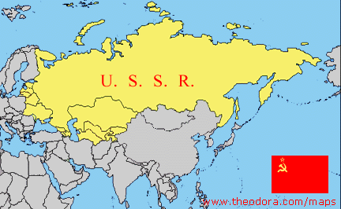
Rise of Dictators
Benito Mussolini
Italy
“Il Duce”
The leader
Adolph Hitler
Germany
Der Fuhrer
The leader
Joseph Stalin
Soviet Union
Japan – Similar, but no Dictator
Military in control

