Slide 1
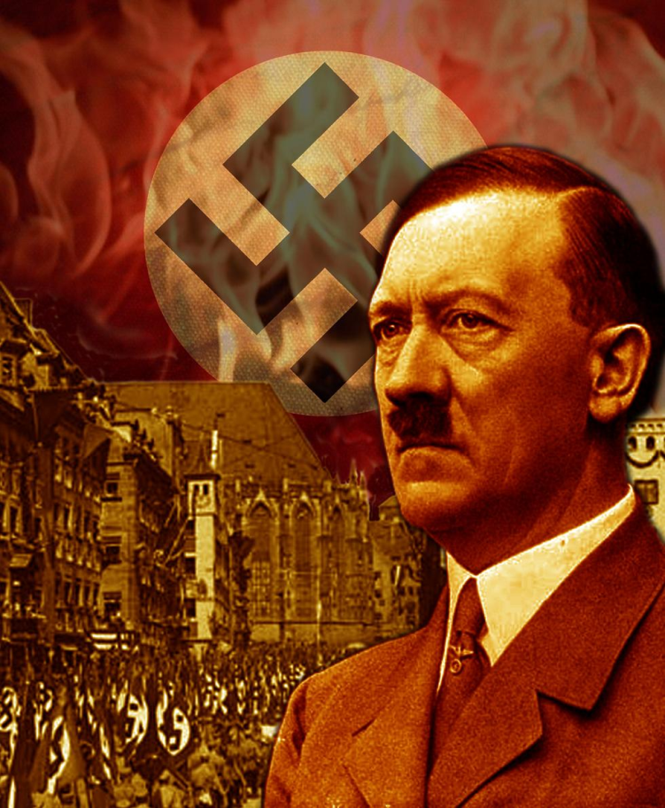
Rise of Dictators
Post WWI countries in rough shape
BUT they rebound – Europe is doing well
THEN The Great Depression
Europe falls apart
People are unemployed
No money, no food
Desperately want help
Turn to anyone

Slide 2
Rise of Dictators
Fascism
Militant Political Movement
Emphasized
Loyalty to the nation (extreme nationalism)
Obedience to the leader
Belief
Do not care about individual rights or democracy
Do not care about communism or capitalism
Its all about making the nation strong
Totalitarian gov’t
Violence, War, and Imperialism are necessary

Slide 3
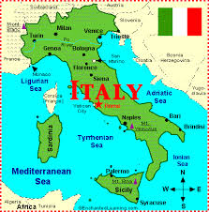
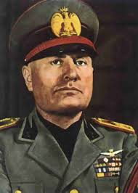
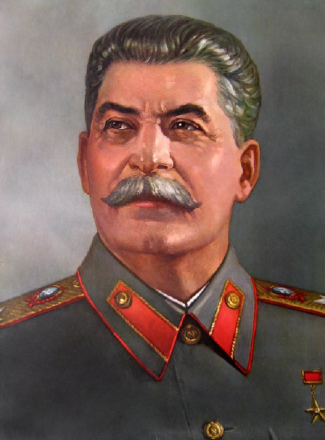
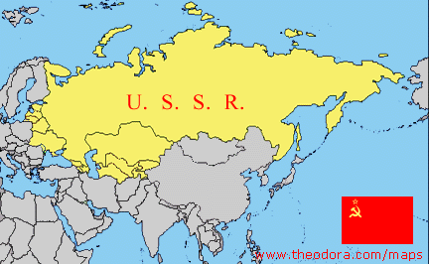
Rise of Dictators
Benito Mussolini
Italy
“Il Duce”
The leader
Adolph Hitler
Germany
Der Fuhrer
The leader
Joseph Stalin
Soviet Union
Japan – Similar, but no Dictator
Military in control

Slide 4
Fascists Plan
Tariffs (tax on importing/exporting) are preventing trade with other nations
Need to sell to more people
Solution – Conquer new land
Hitler (NAZI Germany)
People Need a Job = Military
Military need something to do – Fight!
Hitler takes:
Rhineland
Austria
Sudetenland
Czechoslovakia

