Slide 1
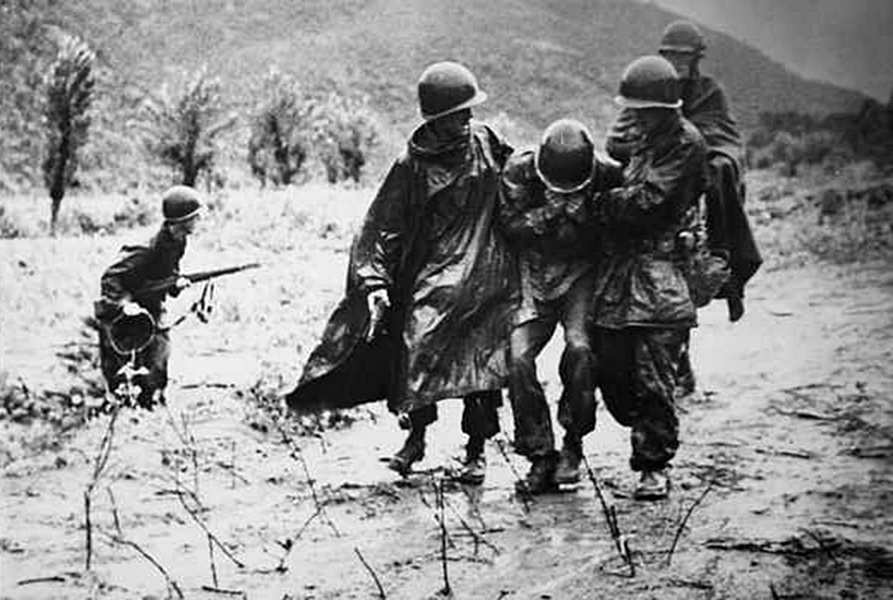
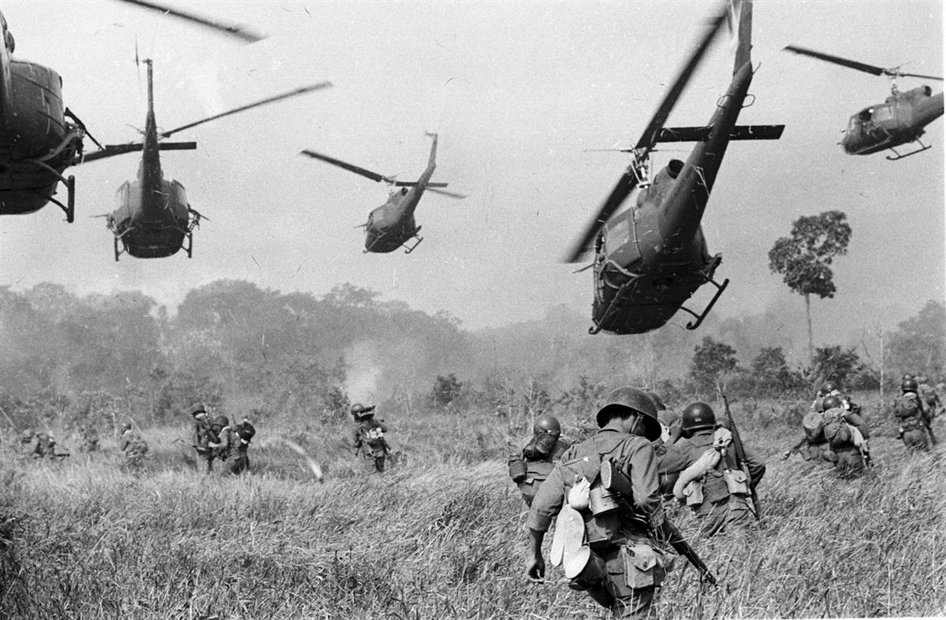
Korea & Vietnam

Slide 2
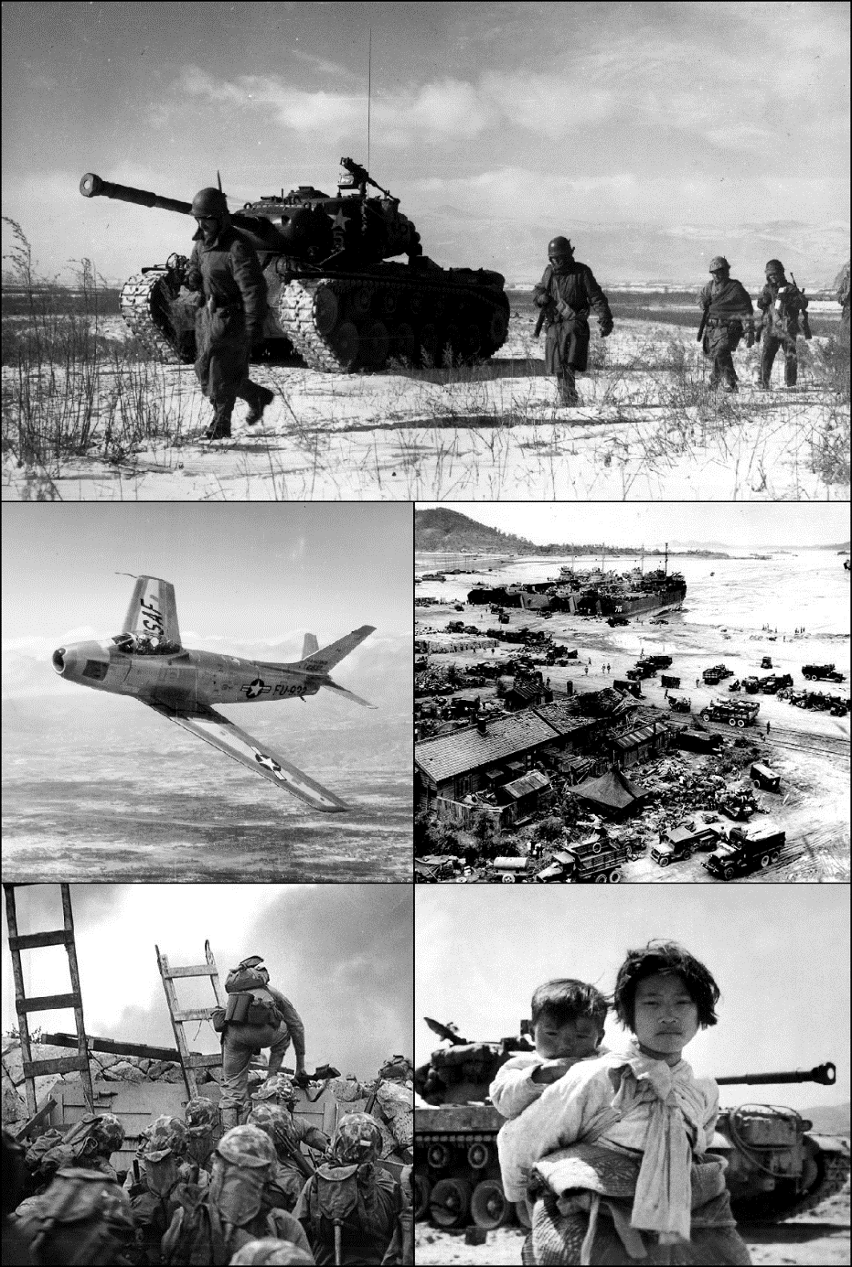
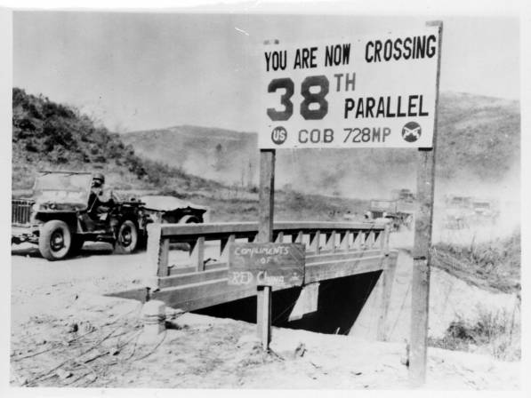
Korean War
First “Hot War” of the Cold War
1950-1953

Slide 3
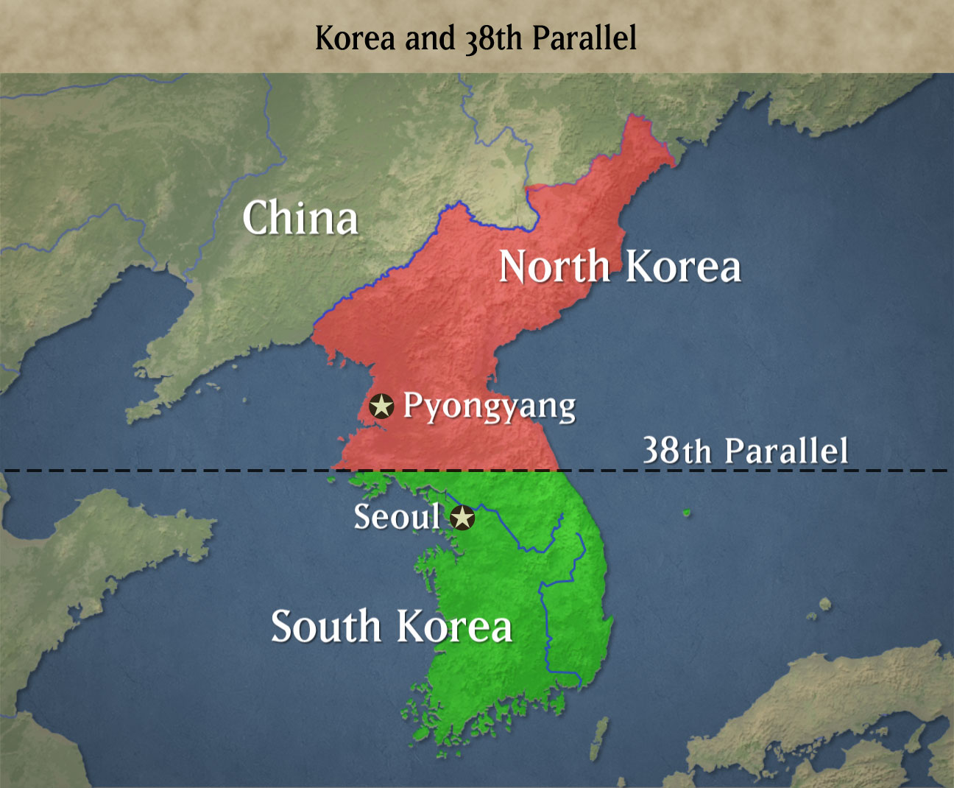
During WWII
The Allies decided to divide Korea at the 38th Parallel.
The North was under the trusteeship of the USSR
The South was under the trusteeship of the USA
This led to the rise of two separate nations:
North Korea = Communist
South Korea = Democratic

Slide 4
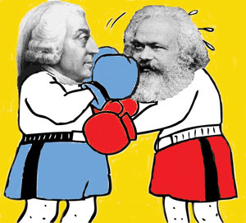
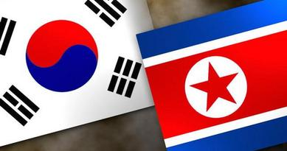
Rise of Tensions
Both sides wanted to re-unify, but wanted to reunite under their own political belief.

Slide 5
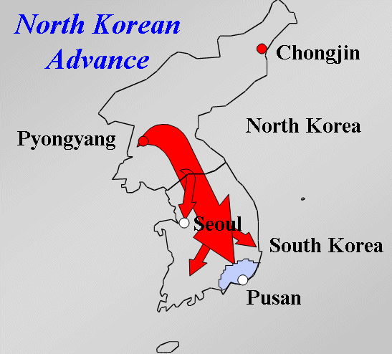
The Start of War
In 1950, after a few skirmishes at the border, war broke out
The USA supported and fought for the South
China supported and fought for the North

Slide 6
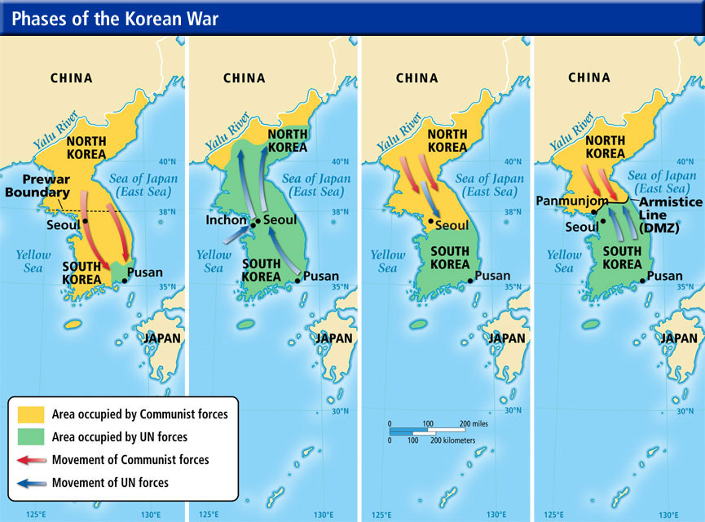
Successes & Failures
Initially, the American and UN forces pushed deep into North Korea
But, after China entered the war, American forces were pushed back into the South

Slide 7
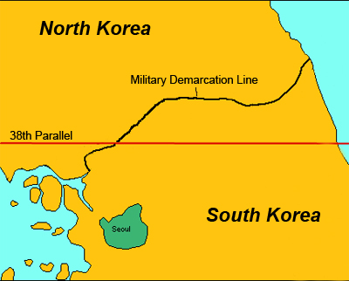
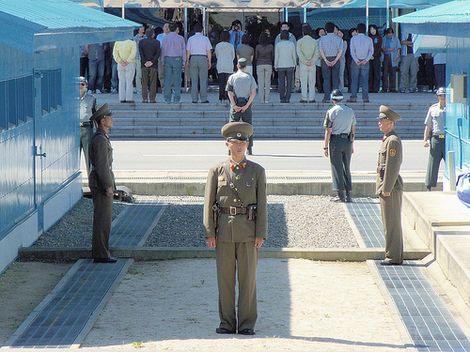
Armistice
After 3 years, the two sides fought to a stalemate.
The countries remained split, divided at the 38th parallel.

Slide 8
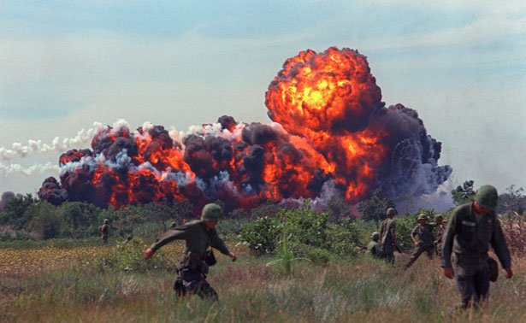
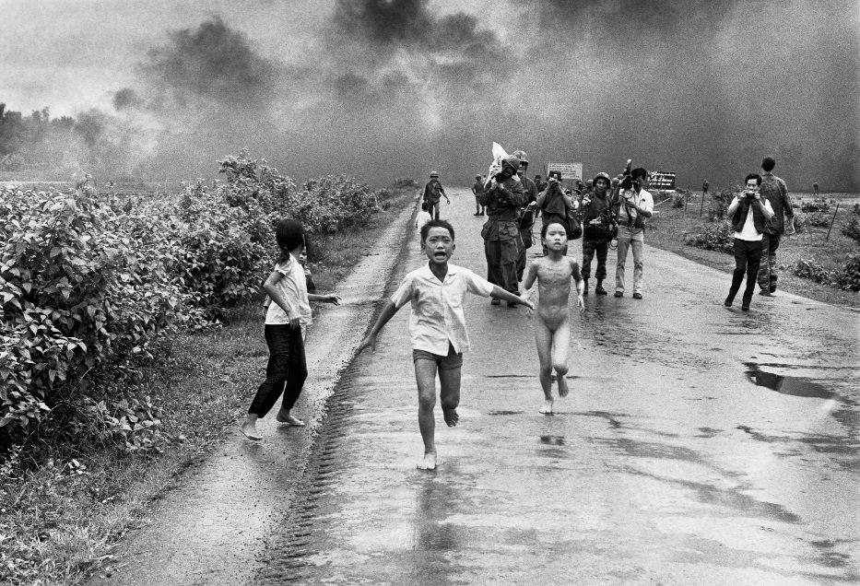
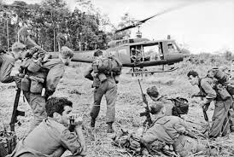
Vietnam War
Second “Hot War” of the Cold War
1955-1975

Slide 9
French Colony
Vietnam was once a French colony
France could no longer look over the land
After leaving, communist countries of USSR & China recognize the Democratic Republic of Vietnam as the official government.
The Viet Minh/Viet Cong would be the pro-communist fighters throughout
Led by Ho Chi Minh

Slide 10
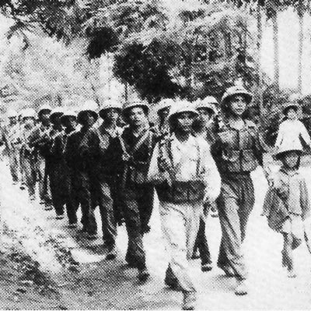
Conflict Rises
Northern communists supports, backed by China and USSR move forward into the south
The USA eventually provides support for the south, and later sends in troops.
Official start for the USA military was the Gulf of Tonkin

Slide 11
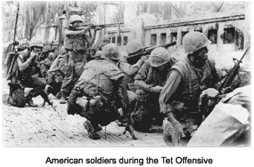
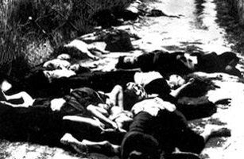
Key Battles
Gulf of Tonkin
Tet Offensive
My Lai Masscre
Viet Cong were successful in guerilla style warfare
Viet Cong also used a vast tunnel system to move soldiers and supplies

Slide 12
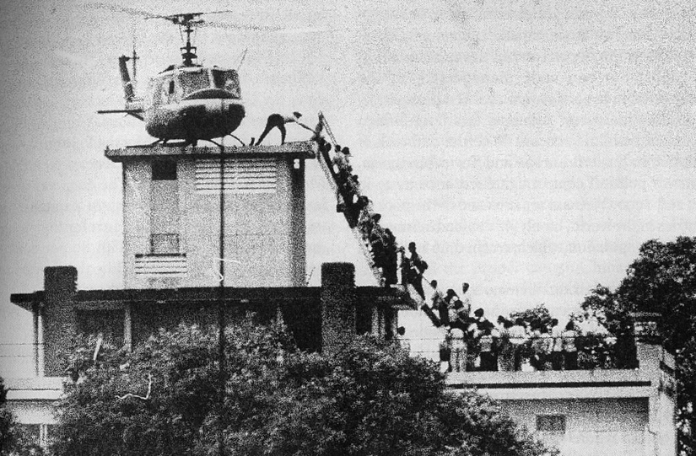
US Exits
After many casualties and failed attempts, the last troops leave Saigon on 29 April, 1975
North Viet Cong would enter the city the next day
Vietnam would become communist throughout the whole country.

Slide 13
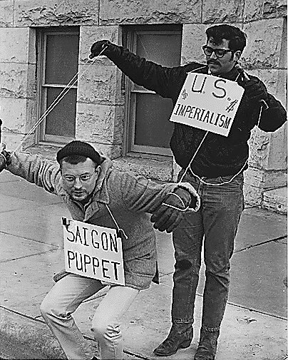
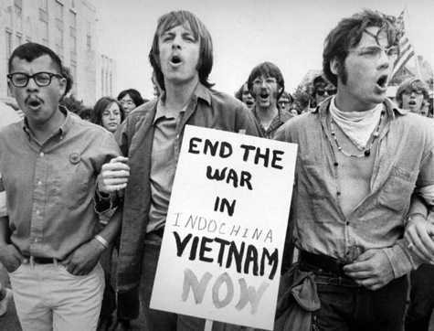
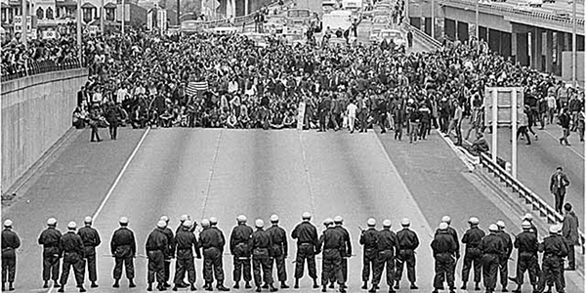
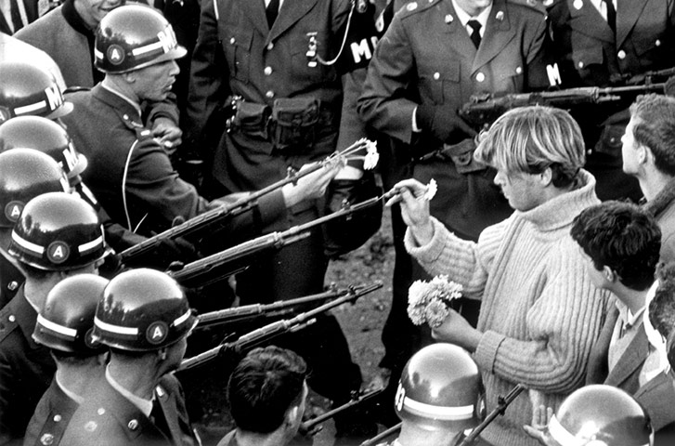
Changed America
Hippy Music

