Slide 1
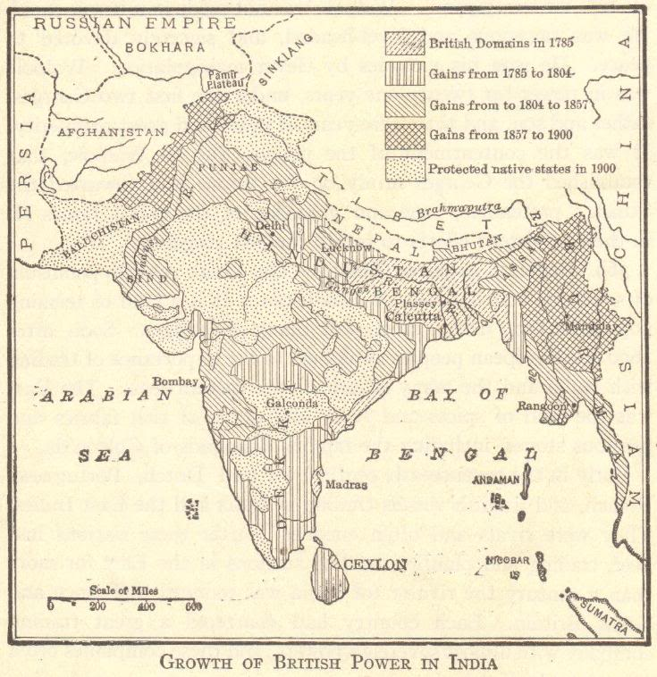
IMPERIALISM: Beginnings and Basic Structures

Slide 2
COLONIALISM SPEEDS UP
Age of Exploration
↓
Europeans raced for overseas colonies
↓
Growth of European commerce and trade worldwide
↓
Commercial Revolution
Notes:
Possible anecdotes: Colonization of the Americas, mercantilism, etc.

Slide 3
“OLD” IMPERIALISM (a.k.a. COLONIALISM)
1500s-1700s
England, France, Holland, Portugal, and Spain
Wars over colonies
Notes:
Possible anecdotes: French and Indian War (Seven Years’ War), Spanish and Portuguese competition in Latin America, etc.

Slide 4
INTERLUDE – LATE 1700s-LATE 1800s
Europeans were preoccupied with happenings on the European continent and in the existing European colonies.
American Revolution
French Revolution
Napoleonic Wars
Latin American Wars for Independence
Growth of Nationalism
Industrial Revolution
Notes:
Possible anecdote: The loss of colonies in the Americas helped spur interest in new colonies while also illustrating the need for change in the nature of imperialism.

Slide 5
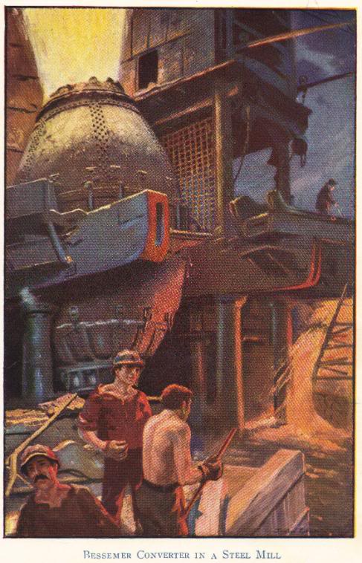
“NEW” IMPERIALISM
Beginning circa 1875
Renewed race for colonies
Spurred by needs created by the Industrial Revolution
New markets for finished goods
New sources of raw materials
Nationalism
Colonies = economic and political power
Social Darwinism = racist justification
Notes:
Possible anecdote: British textile mills required more cotton than could be produced in Great Britain.

Slide 6
WHAT IS “NEW” IMPERIALISM?
No longer about setting up colonies or exercising direct control over areas
Became largely economic
Possession or control of an area for economic gain
Spheres of influence and extraterritoriality rather than colonial settlement

Slide 7
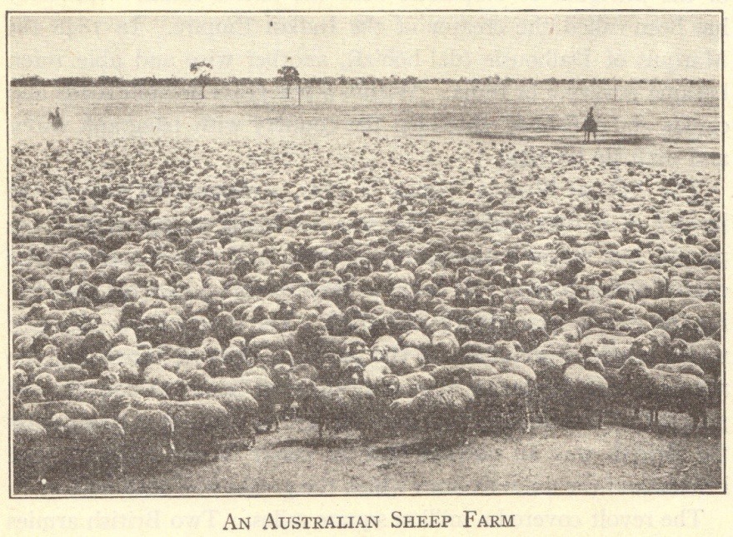
ECONOMIC MOTIVES
Markets for finished goods
Products of British Industrial Revolution sold in China and India
Sources of raw materials
Egypt – cotton
Malaya – rubber and tin
Middle East – oil
Capital investments
Profits from Industrial Revolution invested in mines, railroads, etc., in unindustrialized areas
Notes:
Possible anecdote: Many foreign countries had to be coerced to purchase European goods. Railroads were built throughout Europeans’ colonial possessions and in areas where industrialized nations held economic and political influuence.

Slide 8
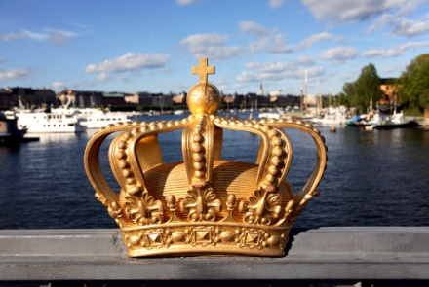
POLITICAL MOTIVES
Nationalism – national pride
“The sun never sets on the British empire.”
Large empires increased national pride
French acquisitions in Africa and Asia followed France’s defeat in the Franco-Prussian War
Notes:
Possible anecdote: The legacy of empires is reflected in languages spoken around the world today, particularly English.

Slide 9
MILITARY MOTIVES
Bases
British naval bases
Aden, Alexandria, Cyprus, Hong Kong, Singapore
Manpower
British – Indian sepoys
French – north African troops
Notes:
Possible anecdote: Compare the use of native troops within the British and French empires with the use of “barbarian” troops within the Roman empire, with the idea that imperial powers historically have never had enough of their own troops to maintain their empires.

Slide 10
SOCIAL MOTIVES
Surplus population
Japanese in Korea
Italians in Africa
“White Man’s Burden”
Rudyard Kipling’s poetry and prose
Whites morally obligated to bring the “blessings of civilization” to “backward” peoples
Cecil Rhodes – imperialism is “philanthropy—plus five percent”
Notes:
Possible anecdote: Did imperial powers bestow any positive benefits? Did these benefits outweigh the costs of colonization?

Slide 11
RELIGIOUS MOTIVES
Conversion to Christianity
End-of-the-century crusading spirit
Missionaries in Africa, Asia, Hawaii, etc.
†
Notes:
Possible anecdote: In what ways did well-intentioned missionaries become cultural imperialists?

Slide 12
JUSTIFICATIONS
Social Darwinism
Interpreted Darwin’s evolutionary theory in terms of powerful nations
“Only the strong survive”
Powerful nations able to develop areas and resources being “wasted” by native peoples
Racism
Increased feelings of white superiority
Increased feelings of Japanese superiority
Eugenics developed as a branch of science
Notes:
Possible anecdote: Racism and eugenics developed and/or increased simultaneously to justify the dominance of imperial powers, both among the Japanese and Europeans.

Slide 13
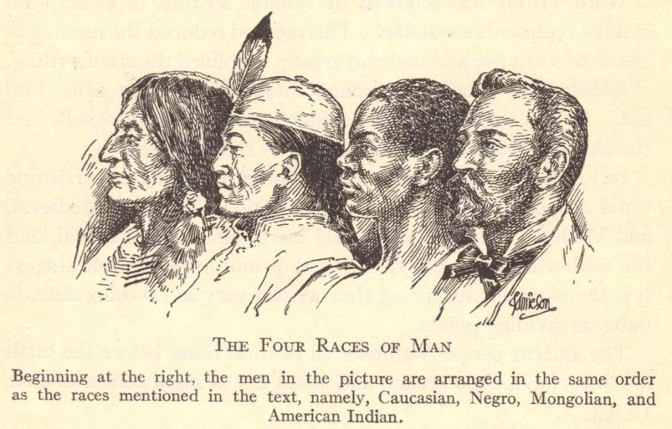
CONCEPT OF “RACES” CIRCA 1900
Notes:
Possible anecdote: Discussion about how the concept of races is outdated and has been proven incorrect through modern research into human migrations and DNA.

Slide 14
REVIEW QUESTIONS
Describe three motives for imperialism.
Which nations became imperial powers?
Which nations were controlled by imperial powers?
How did imperial powers justify their control over foreign nations?

