Slide 1
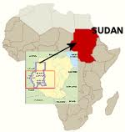
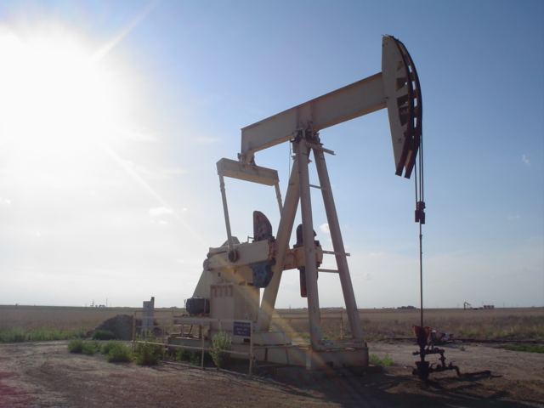
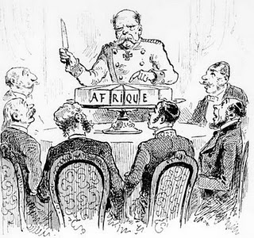
Genocide in Darfur
Darfur is a part of Sudan
It is home to many diverse people as the result of imperialist boundaries created at the Berlin Conference
Many conflicts have occurred between Arabs and Non-Muslims
Many conflicts have occurred over the control of scarce resources

Slide 2
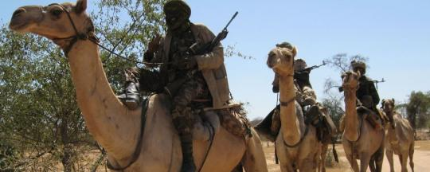
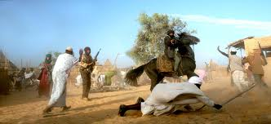
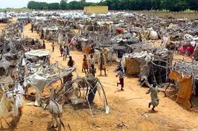
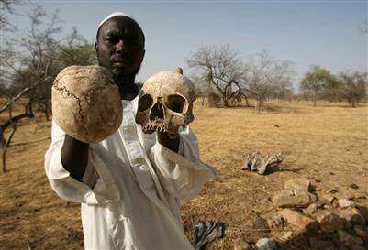
Genocide in Darfur
Darfur sought independence from Sudan (2003)
Darfur believed the Sudanese Gov’t was mistreating Non-Arab citizens
Sudanese Gov’t responded with violence
Janjaweed (‘devils on horseback’) attacked Non-Arabs
400,000 people have died
2.5 million have become refugees

Slide 3
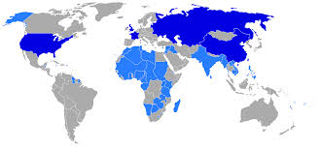
Genocide in Darfur
In 2010, a cease fire was signed
The situation in Darfur continues
Many criticize the US for not intervening
Normally the United Nations steps in
International government that keeps the peace
Big Five
No!

Slide 4
Should the US get involved?
Write a FORMAL letter to the President of the US
PERSUADE him to intervene in Darfur
Give reasons:
Explain what is happening
Discuss other genocides that have happened in the world
or
PERSUADE him to say out of Darfur
Give Reasons:
Explain what is happening
Discuss what might happen if Americans get involved
http://www.youtube.com/watch?v=USLDoIiFzzg

Slide 5
4700 Burlington Mills Rd
Rolesville, NC 27571
President Barack Obama
1600 Pennsylvania Ave NW
Washington, DC 20500
Dear Mr. President,
Paragraph #1 – Why are your writing
Paragraph #2 – Explain the situation in Darfur
Paragraph #3 – Explain past examples of genocide and what will happened if the US doesn’t get involved …or… Explain the negative consequences of US involvement.
Sincerely,
Sign your name
Print your name

Slide 6
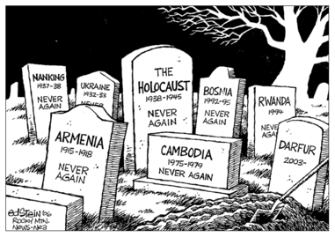

Slide 7
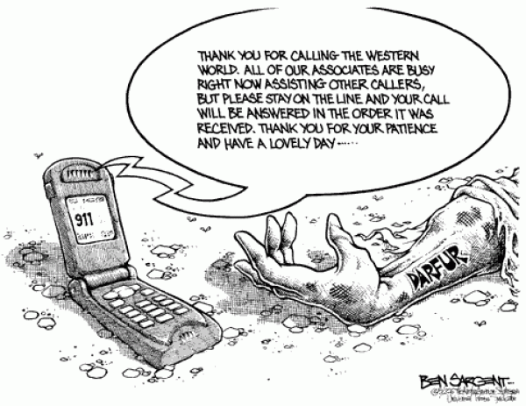

Slide 8
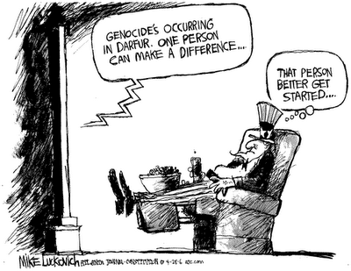

Slide 9
