Slide 1
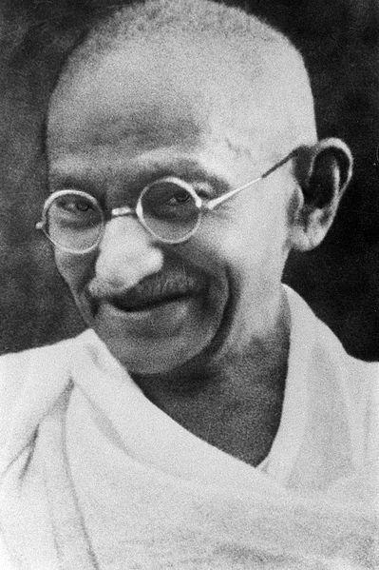
Gandhi
And, India’s Independence

Slide 2
Early Years
Porbandar
Ghandi was born in Porbandar, India in 1869
He was the youngest of six children.
When Gandhi was 13 years old he married Hasturbai Makanji.
  Their marriage lasted for 62 years.

Slide 3
Early Years
Gandhi went to London to study law when he was 19.
Instead of wearing an Indian turban and loose-fitting clothes, he wore British clothes/a suit.
After he got his law degree he returned to India and began practicing law in Bombay.
Bombay

Slide 4
Gandhi in Africa
Just a couple of years later, he was asked to represent an Indian company in a civil suit in South Africa.
While he was there, he bought a first class ticket to Pretoria. But, he was not allowed to sit in the seat he purchased. He was told to sit in the baggage car. He refused and was kicked off the train.

Slide 6
Gandhi in Africa
Just a couple of years later, he was asked to represent an Indian company in a civil suit in South Africa.
While he was there, he bought a first class ticket to Pretoria. But, he was not allowed to sit in the seat he purchased. He was told to sit in the baggage car. He refused and was kicked off the train.
After that, Gandhi resolved to fight back legally. Life was harsh for both Indians and blacks. For example, Indians and blacks could be arrested for walking on the same sidewalk as whites.

Slide 7
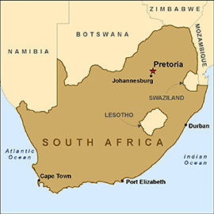
Pressure Builds
South Africa tried to stop Indian immigration and law makers wanted to deny Indians the right to vote. Gandhi took up their cause.
As news spread, world opinion pressured the British colonial office to say that every citizen of the British Empire had the right to vote and the right to emigrate anywhere in the empire.
  Unfortunately, white law makers in South Africa overruled the Colonial Office. Gandhi led the fight against these unjust laws, protesting and leading marches against the government.
In 1914 South Africa passed the Indian Relief Act, which put an end to most of these laws.

Slide 9
Return to India
Gandhi remained in South Africa for 20 years, but after the outbreak of WWI, he returned to India.
  He called for Indians to help England win the war.
After the war ended, Gandhi called for independence.
Great Britain passed censorship laws, banned freedom of assembly, and even Gandhi’s writings.

Slide 10

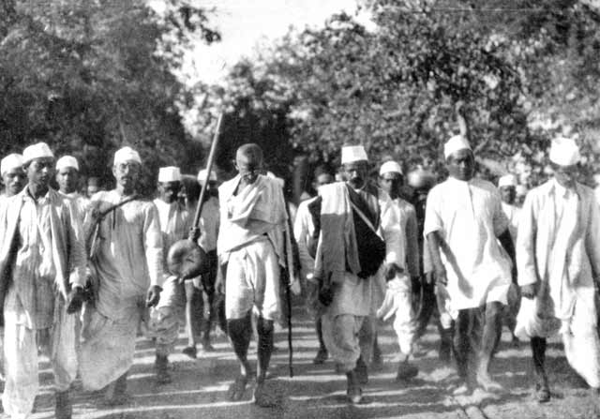
Non--Violence
Gandhi call for a non-violent strike. “Non-violence,” he said, “is a weapon for the brave.” Still, violence did occur.
  Nearly 15,000 people held an illegal meeting in Amritsar.
  The British army fired on the crowd and many people died.
Gandhi encouraged Indians to grow their own food and to spin their own cloth.
In 1930 Gandhi led a march to the sea to protest the British tax on salt
  Known as “The Salt March”

Slide 12
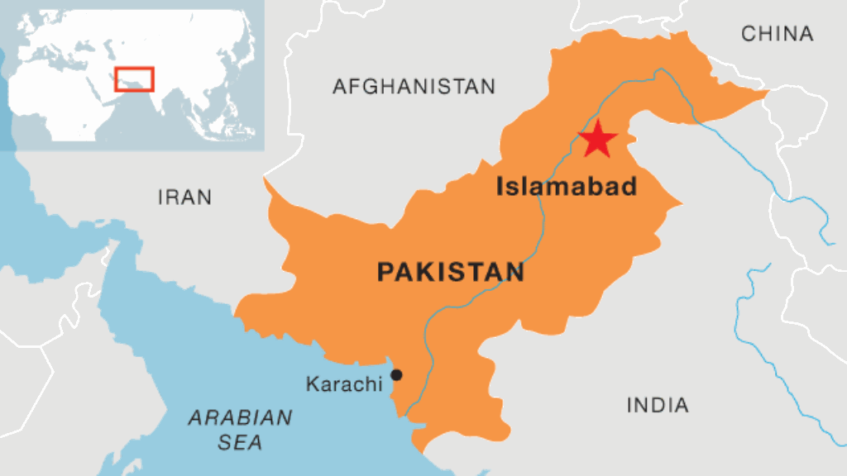
Fighting for Independence
During WWII, Gandhi demanded independence. He called for civil disobedience. He and many of his followers were jailed for treason.
  While Gandhi was in prison there were many riots.
In 1946, England proposed independence for India. Some Indian Muslims wanted their own country.
India gained its independence in August of 1947!
  Pakistan, a Muslim state, was carved out of West and East India.
Some Hindus were bitter that Gandhi had reconciled with the Muslims.
In January 1948 Gandhi was assassinated by an angry Hindu.

