Slide 1
The student will know:
Key terms including but not limited to:
o Pandemic o Epidemic o Communicable disease o Deficiency o Environmental factors o Immunity o Biological Warfare o NGO (non-governmental organization)
How disease spreads between cultures.
Ways that cultures address the impacts of disease.

Slide 2
Terms
o Pandemic o Epidemic o Communicable disease o Deficiency o Environmental factors o Immunity o Biological Warfare o NGO (non-governmental organization)

Slide 3
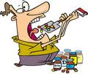
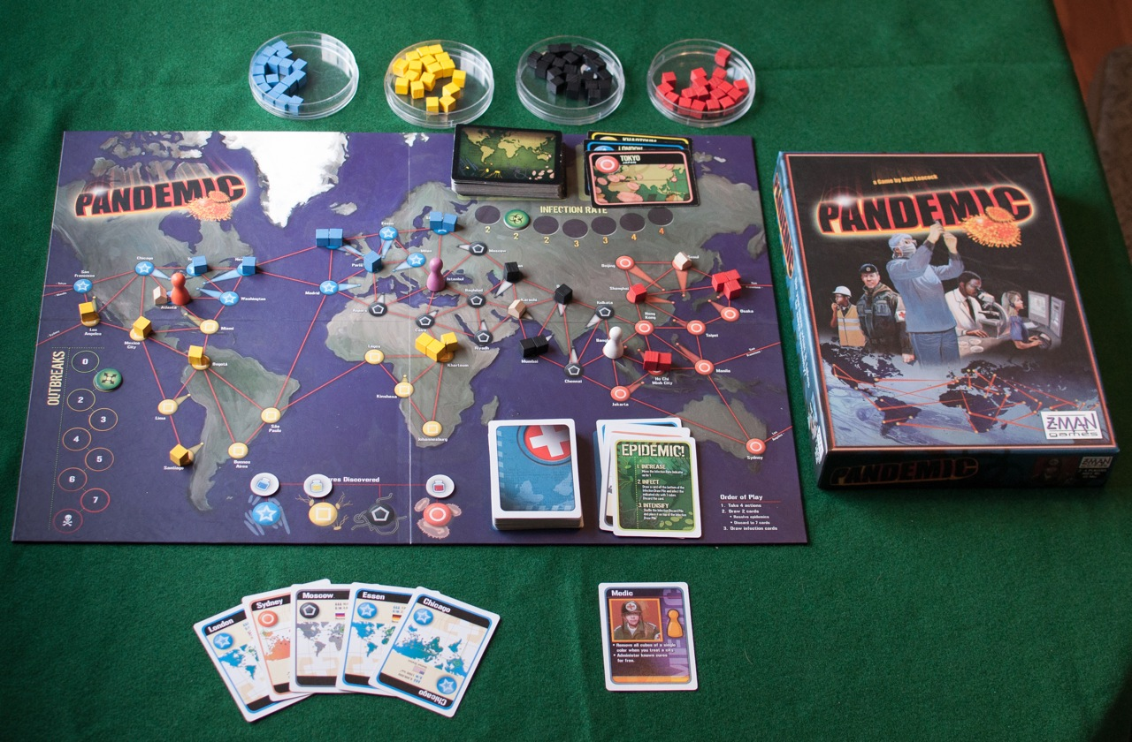
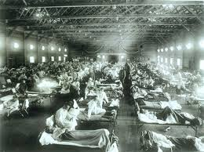
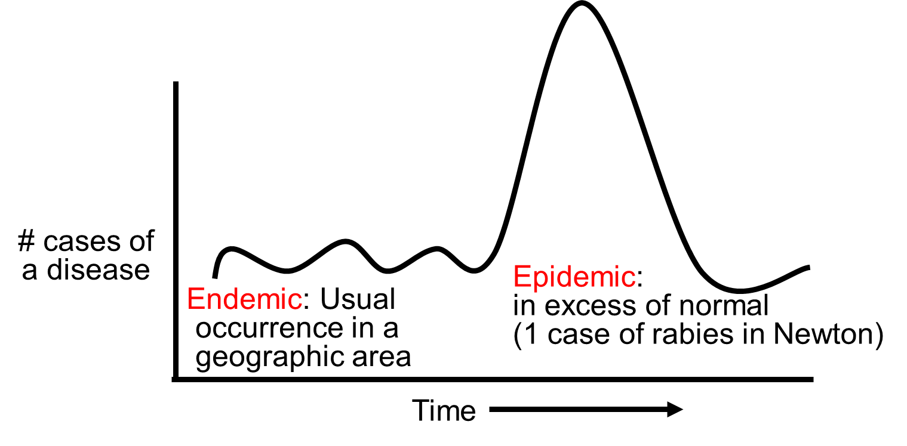
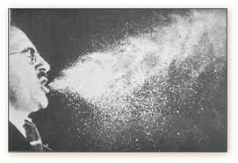
Terms
Pandemic
infectious disease that has spread worldwide
Epidemic
High rate of a disease over short period of time in a region
Communicable disease
an infectious disease transmissible by direct contact with an affected individual
Deficiency
a shortage of substances (as vitamins) necessary to health

Slide 4
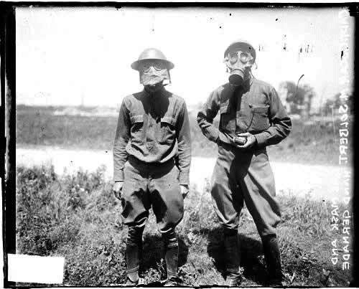
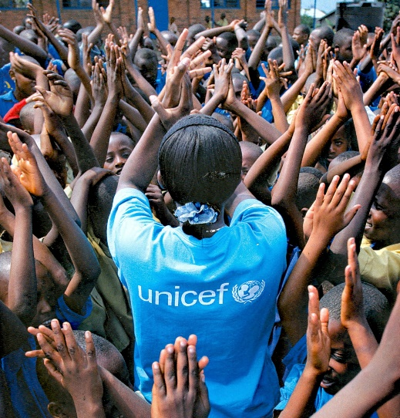
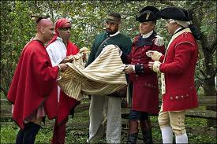
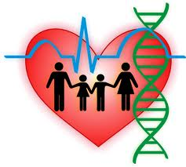
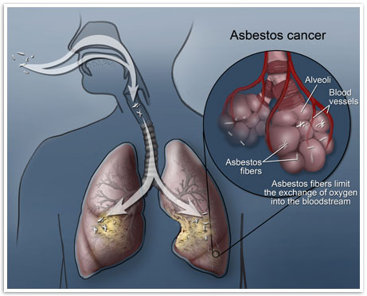
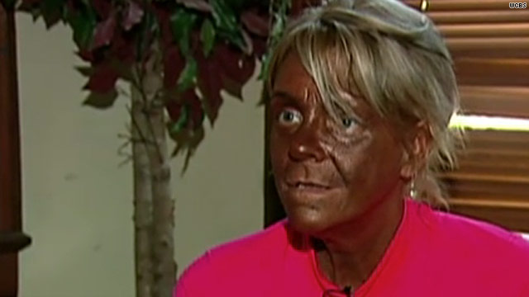
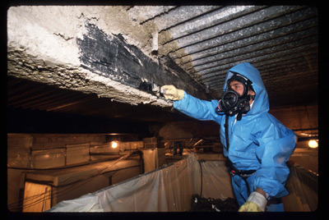
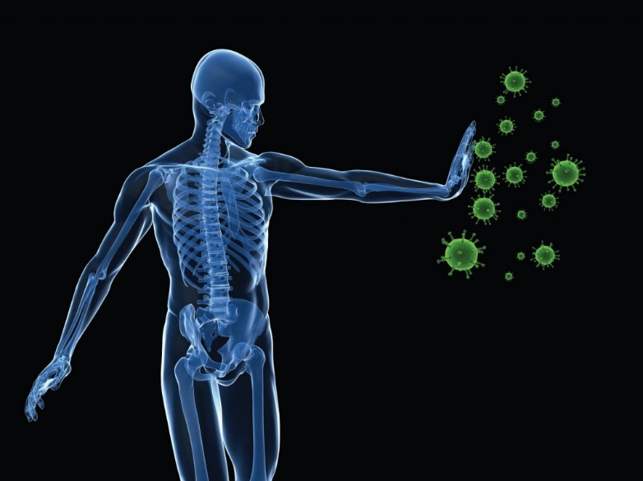
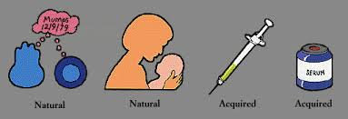
Terms
Environmental factors
Disease not caused by genetics or infection
Lifestyle: Stress, lack of sleep & exercise, diet, etc
Environment: excess sun
Chemical exposure (http://www.youtube.com/watch?v=zIJErVlVOY8)
Immunity
a condition of being able to resist a particular disease
Biological Warfare
Weapons that spread disease NOT explosions
NGO (non-governmental organization)
group of people working together to make the world better

Slide 5
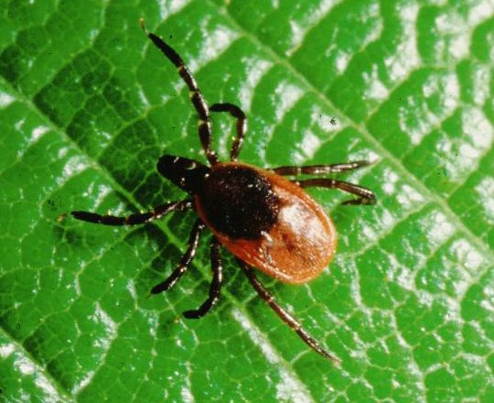
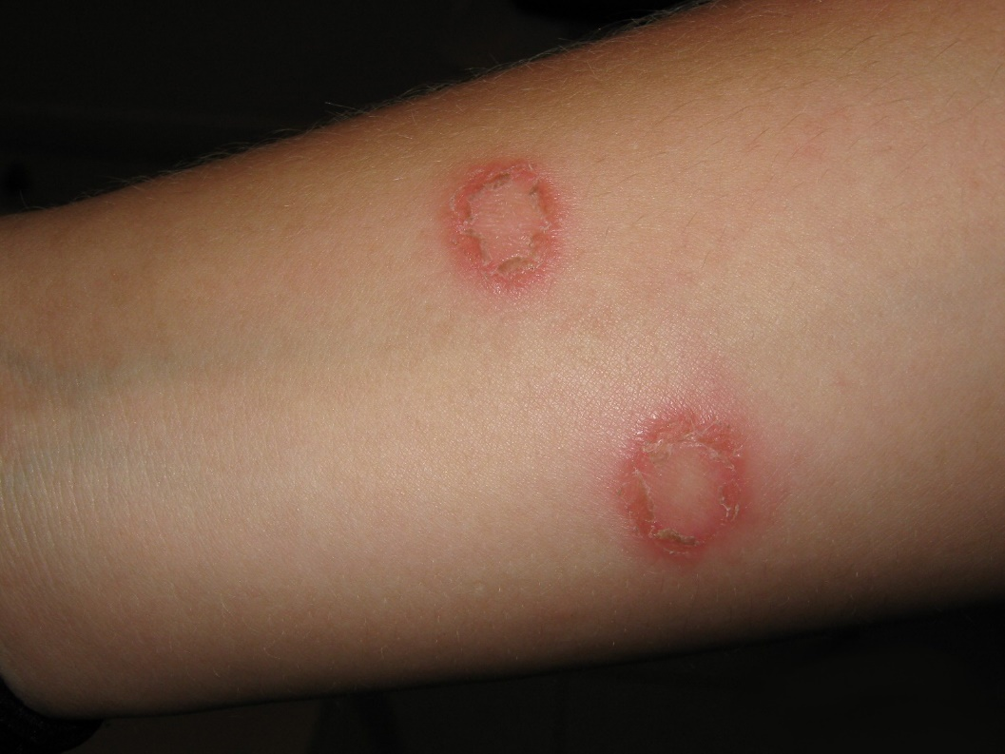
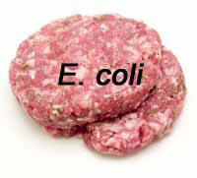
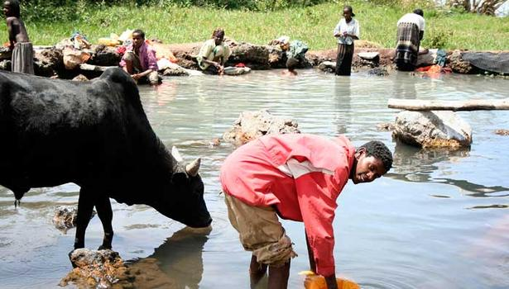
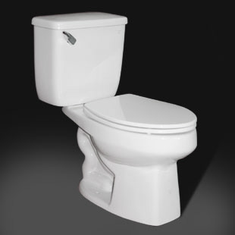
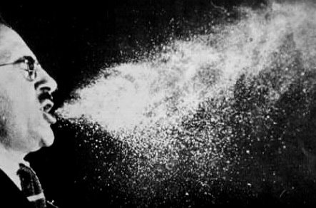
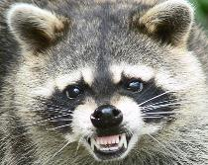
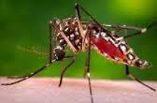
How disease spreads between cultures:
Person to Person
Airborne droplets
Human waste
Blood
Direct contact w/skin
Intimate Contact
Water
Food
Animal Contact

